Slide 1


Not so stupid shell tricks
tips & tricks to simplify shell navigation
@brettm
Notes:
A few tips and trips to hopefully make using the shell a little more efficient.

Slide 2
Let’s start with a clean slate
CTRL-l
Notes:
Instead of typing `clear` continually try ctrl-l
Simple to type
Doesn’t pollute history
An example

Slide 3
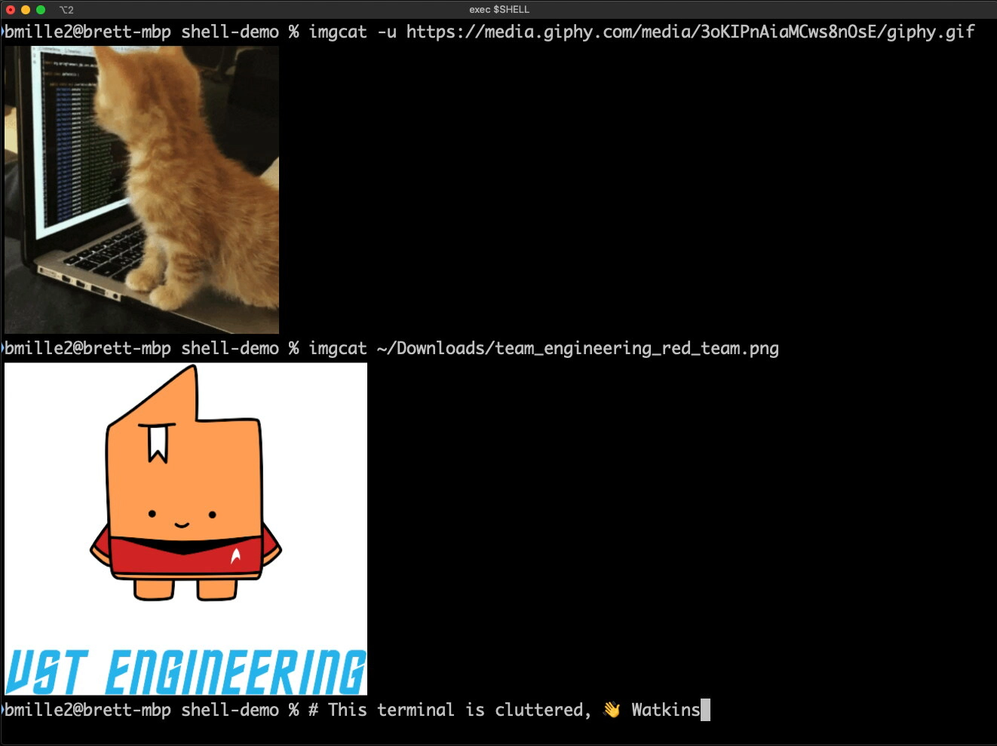
K Thx Bye

Slide 4
Use the past to simplify the future
(history)
CTRL-p / CTRL-n - Go back in history list/go forward in history list
CTRL-r - Reverse search history.
^foo^bar - Replace ‘foo’ with ‘bar’ in first matching string of previous command
!!:gs/foo/bar/ - Replace ’foo’ with ‘bar’ globally (for all matches of ‘foo’) in previous
command (!!:s/foo/bar/ is the same as ^foo^bar)
!! - Refer to previous command (in full)
ESC . / ALT-. - Insert last argument to previous command (tap ESC then .)
Notes:
Cmds to help navigate and reuse cmds (or parts of cmds) from your history
On Mac Option is ALT
CTRL-p/CTRL-n - scroll through history like using arrows w/o moving hands from home row
CTRL-r - search history for pattern, ctrl-r again to continue back (‘up’) through the history
The rest of the cmds do operations or modifications on the previous cmd
Next a video with examples of each (in order)

Slide 5
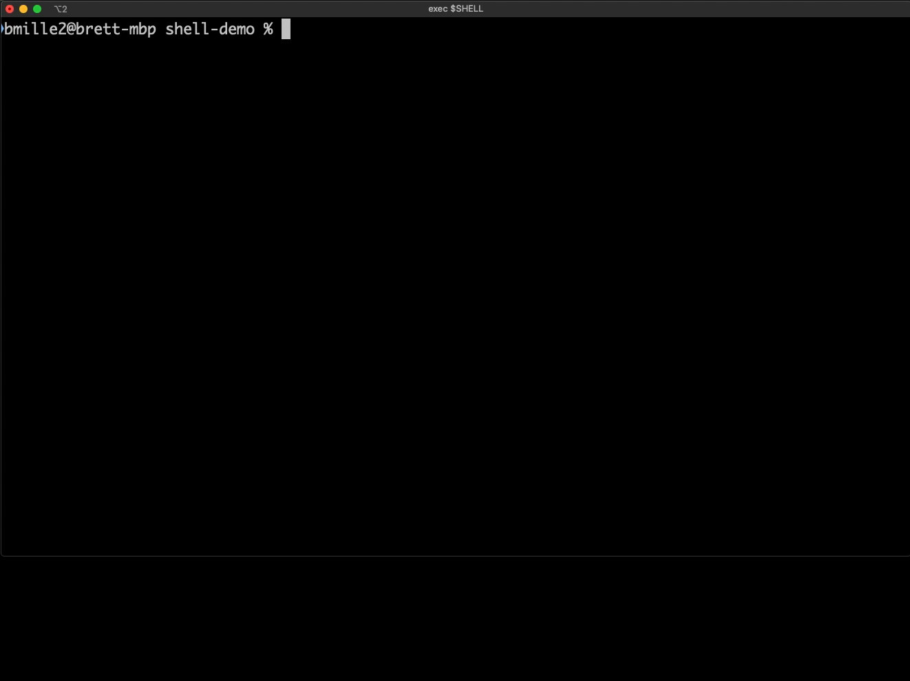
Let do the time warp

Slide 6
It’s just a jump to the left
(cursor movement and deleting)
CTRL-a / CTRL-e - go to beginning/end of line
CTRL-f / CTRL-b - move forward/backward one character
ALT-f / ALT-b - move forward/backwards one word
CTRL-d / CTRL-h - delete forward/backward from cursor one character
ALT-d / ALT-backspace - delete forward/backward from cursor one word
CTRL-w - alternate of ALT-backspace
Notes:
Commands to help quickly move around and delete text on your command line
Here a a few examples (in order)

Slide 7
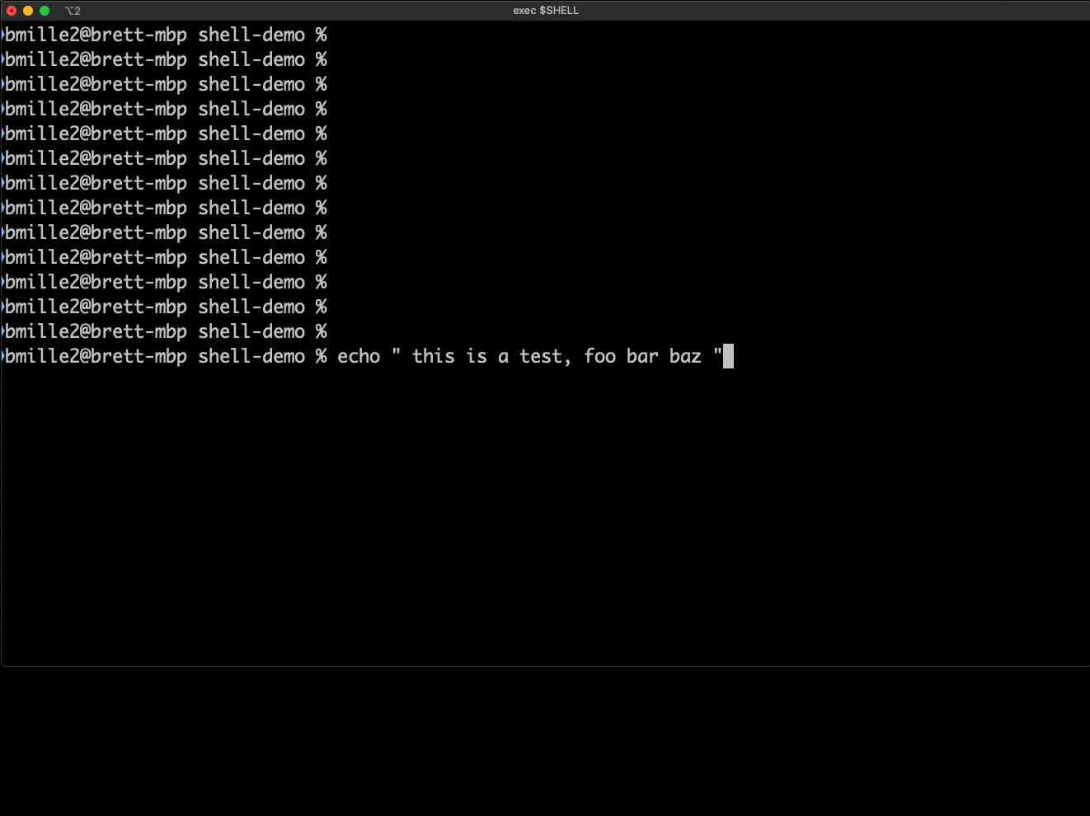
And then a slide to the right

Slide 8

@brettm
https://github.com/brettmiller/not-so-stupid-shell-tricks
Notes:
My slack
The slides and videos are available on my Github page.
Time permitting – some quick expansion tricks
# Expansion
cp file.{json,yaml}
mv file{,.txt}
mv my-{new,old}-file.txt

